Slide 1
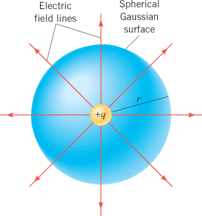
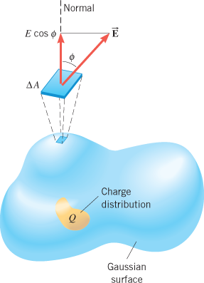
Gauss' Law
Gauss' Law:
The electric flux, Φ_{E} through a Gaussian surface is equal to the net charge Q enclosed by the surface divided by, ϵ₀ the permittivity of free space:

Slide 2
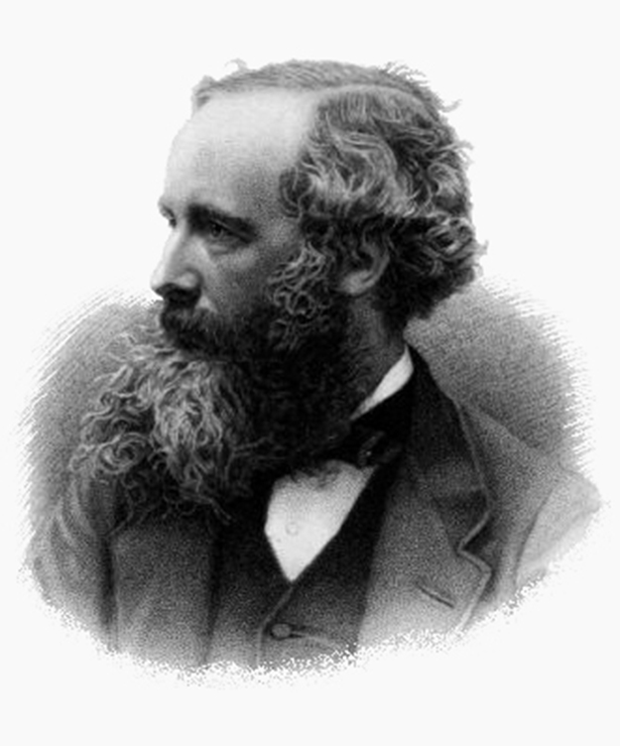
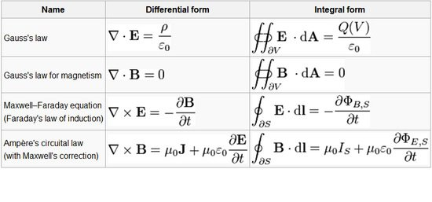
Electromagnetic Waves
James Clerk Maxwell, a 19th-century physicist, developed a theory that explained the relationship between electricity and magnetism and correctly predicted that visible light is caused by electromagnetic waves. (credit: G. J. Stodart)
https://www.youtube.com/watch?v=MkjvgZaOJxo

Slide 3
Generation and Detection of EM wave
The apparatus used by Hertz in 1887 to generate and detect electromagnetic waves. An $RLC$ circuit connected to the first loop caused sparks across a gap in the wire loop and generated electromagnetic waves. Sparks across a gap in the second loop located across the laboratory gave evidence that the waves had been received.

Slide 4
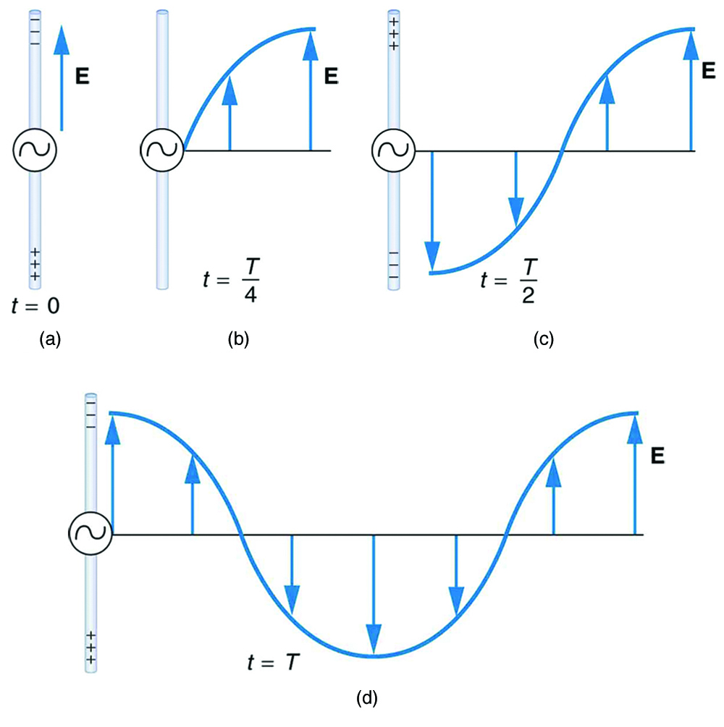
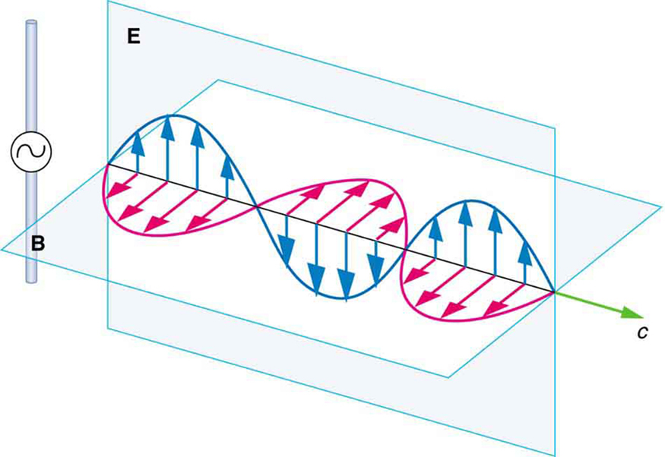
Production of Electromagnetic Waves
The electric field ( E ) and the magnetic field (B) propagate away from the antenna at the speed of light, forming an electromagnetic wave.

Slide 5
Speed of Electromagnetic Waves
All electromagnetic waves move through a vacuum at the same speed, and the symbol c is used to denote its value.
This speed is called the speed of light in a vacuum and is c = 3.00 × 10⁸ m/s.
In air, electromagnetic waves travel at nearly the same speed as they do in a vacuum, but, in general, they move through a substance such as glass at a speed that is substantially less than c.
In 1865, Maxwell determined theoretically that electromagnetic waves propagate through a vacuum at a speed given by,
http://hyperphysics.phy-astr.gsu.edu/hbase/Tables/funcon.html

Slide 6
The Speed of Light
The time required for light to travel between two places on earth is very short.
1907 Nobel prize winner, Michelson used a rotating eight-sided mirror to measure the speed of light.
Today, the speed of light has been determined with such high accuracy that it is used to define the meter.
c = 299,792,458 m/s
https://www.youtube.com/watch?v=V7PU1WN9jWY

Slide 7
Relating E -Field and B -Field Strengths
What is the maximum strength of the B -field in an electromagnetic wave that has a maximum E -field strength of 1000 V/m ?

Slide 8
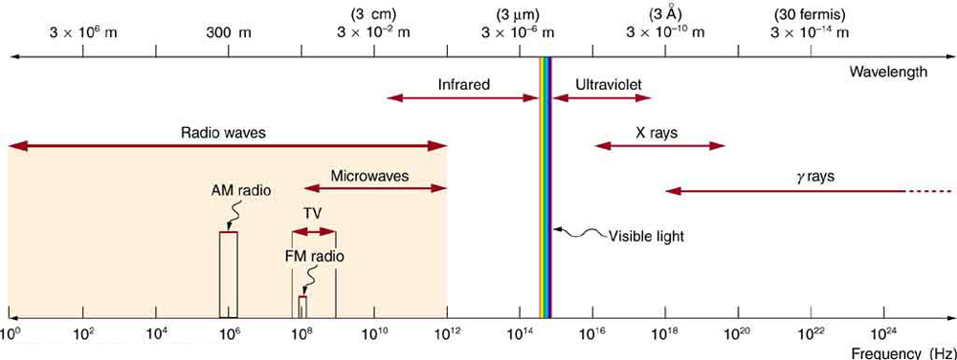
The Electromagnetic Spectrum
Calculate the wavelengths of a 1530-kHz AM radio signal, a 105.1-MHz FM radio signal, and a 1.90-GHz cell phone signal.

Slide 9
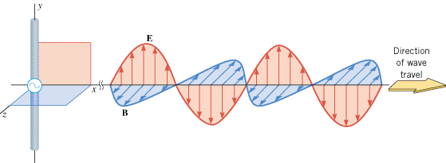
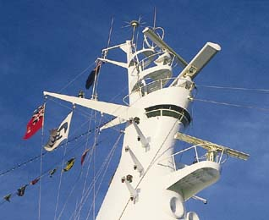
Radio and TV reception
This cruise ship uses both straight wire and loop antennas to communicate with other vessels and on-shore stations.
A radio wave can be detected with a receiving antenna wire that is parallel to the electric field of the wave.
With a receiving antenna in the form of a loop, the magnetic field of a broadcasted radio wave can be detected.

Slide 10
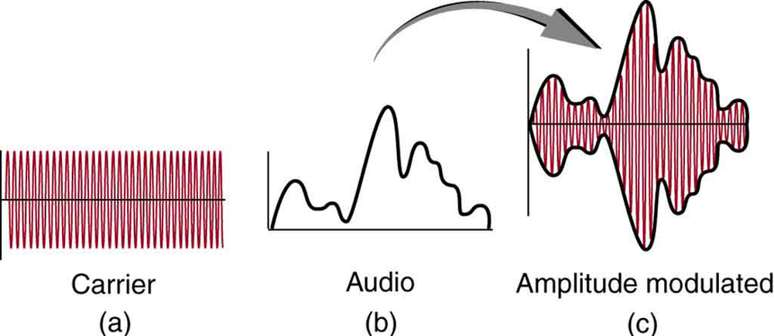
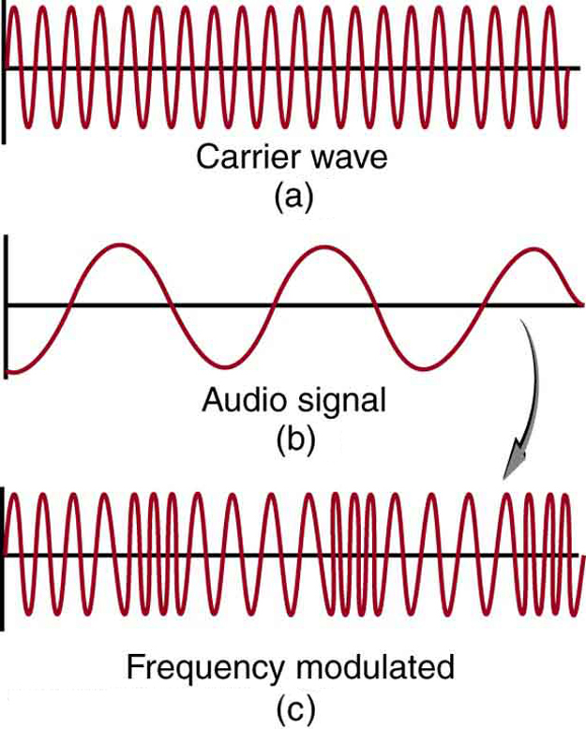
How radio works?
At the radio station sound waves are converted into electromagnetic waves, then encoded and transmitted in the radio-frequency range. The radio in your car receives the radio waves, decodes the information, and uses a speaker to change it back into a sound wave.

Slide 11
Cochlear Implant
Hearing-impaired people can recover part of their hearing with the help of a cochlear implant. The broadcasting and receiving of electromagnetic waves lies at the heart of this device.

Slide 12
Wireless Capsule Endoscopy
This wireless capsule endoscope is designed to be swallowed. As it passes through a patient’s intestines, it broadcasts video images of the interior of the intestines.

Slide 13
Crab Nebula
Four views of the Crab Nebula, which is the remnant of a star that underwent a supernova explosion in 1054 AD. It is located 6300 light-years away from the earth.

Slide 14
How a microwave heats food?
In a microwave oven, the rotating fan blades reflect the microwaves to all parts of the oven and water molecules in the food absorb it.
The absorption occurs because each water molecule has a permanent dipole moment.
The electric field of the microwaves exerts forces on the positive and negative ends of a molecule, causing it to spin.
As the internal energy increases, the temperature of the water increases, and the food cooks.

Slide 15
The Greenhouse Effect
The energy carried by electromagnetic waves in the infrared and visible regions of the spectrum plays the key role in the greenhouse effect that is a contributing factor to global warming.

Slide 16
The Doppler Effect and Electromagnetic Waves
When electromagnetic waves and the source and the observer of the waves all travel along the same line in a vacuum (or in air, to a good degree of approximation), the single equation that specifies the Doppler effect is,

Slide 17
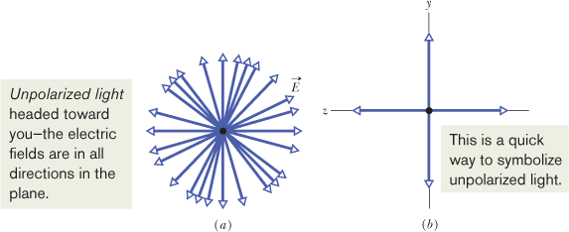
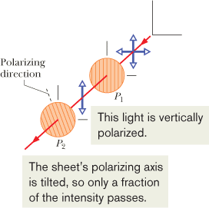
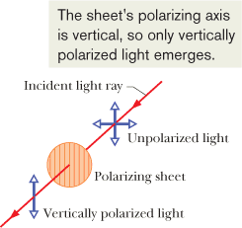
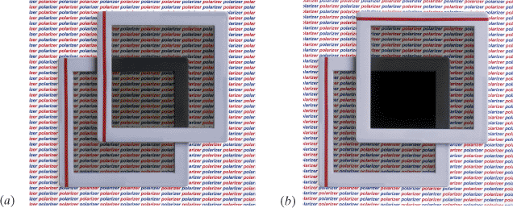
Polarized Light
https://www.youtube.com/watch?v=2ilIPNu1ab0&t=52s
The electromagnetic waves emitted by any common source of light (such as the Sun or a bulb) are unpolarized or polarized randomly.
That is, the electric field at any given point is always perpendicular to the direction of travel of the waves but changes directions randomly.

